Slide 1



Biocompatibility of Medical Devices
17th Jan 2022
TCS Internal

Slide 2



Introduction
Biocompatibility of medical devices
ISO 10993-1:2018 Biological evaluation of medical devices — Part 1: Evaluation and testing within a risk management process
A measurement of how compatible a medical device or material is, when it comes in contact with patient. i. e, works as intended without inflicting any unknown harm to the patient.
A guideline document which specifies the following:
— the general principles governing the biological evaluation of medical devices within a risk management process;
— the general categorization of medical devices based on the nature and duration of their contact with the body;
— the evaluation of existing relevant data from all sources;
— the identification of gaps in the available data set on the basis of a risk analysis;
— the assessment of the biological safety of the medical device.
When Biocompatibility is considered
New devices: If any material used in the device come into direct or indirect contact with human body.
Modified devices:
If the changes are to any direct or indirect contacting materials
Added a new internal component or removing an existing component which has direct impact on the contacting material
Biological Evaluation
ISO 10993 evaluates the medical device in its final stage
Protection of humans is the primary goal
Secondary goal is to ensure animal welfare and to minimize the number and exposure of the test animals
It is a procedure which is performed to determine the potential toxicity resulting from contact of material of medical device with the body.
Block Diagram
Medical Device in Final Finished Form
Categorization of MD
Systematic approach to a biological evaluation
Biological Testing and
Risk management
Mitigate Risk by considering available information
Test Reports,
Device Master Files, Component and Device Documentation
Submission to FDA
TCS Internal

Slide 3
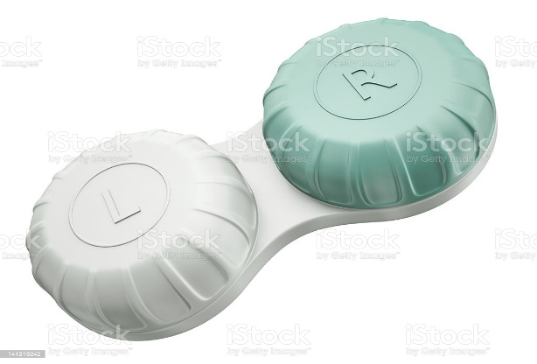
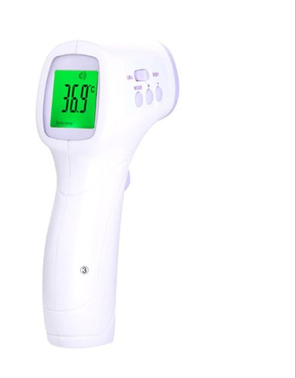
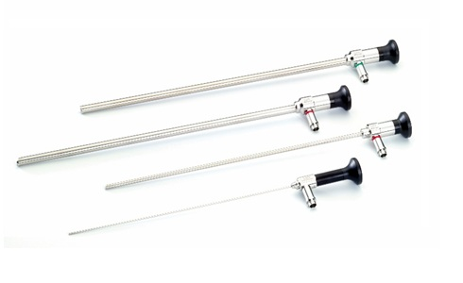
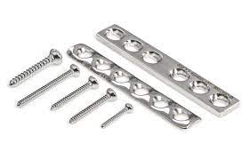
Medical Device in Final Finished Form
Categorization of MD
Systematic approach to a biological evaluation
Biological Testing and
Risk management
Mitigate Risk by considering available information
Test Reports,
Device Master Files, Component and Device Documentation
Submission to FDA
By nature of body of contact
By duration of contact
Surface contacting
Skin (eg: bandages)
Mucosal membranes (eg: contact lenses)
Limited exposure (A) – medical devices whose cumulative sum of single, multiple or repeated duration of contact is up to 24 h.
Prolonged exposure (B) – medical devices whose cumulative sum of single, multiple or repeated contact time is likely to exceed 24 h but not exceed 30 d.
Long-term exposure (C) – medical devices whose cumulative sum of single, multiple or repeated contact time exceeds 30 d.
Non-contacting
Neither direct nor indirect contact with the body
Eg: Diagnostic software, a blood-collection tube
Implant Medical Devices
Tissue / Bone (eg: plates, pacemakers)
Blood (eg: heart valves)
Externally communicating MD
Blood path, indirect (deliver fluids into the vascular system)
Tissue / Bone (eg: laparoscopes)
TCS Internal

Slide 4
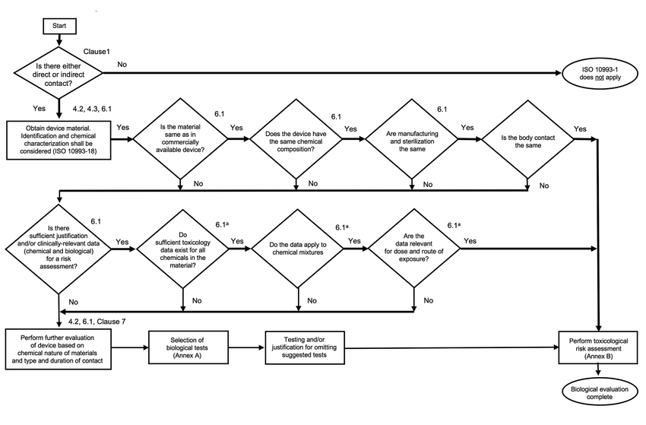
Systematic approach to a biological evaluation of medical devices
Medical Device in Final Finished Form
Categorization of MD
Systematic approach to a biological evaluation
Biological Testing and
Risk management
Mitigate Risk by considering available information
Test Reports,
Device Master Files, Component and Device Documentation
Submission to FDA
TCS Internal

Slide 5
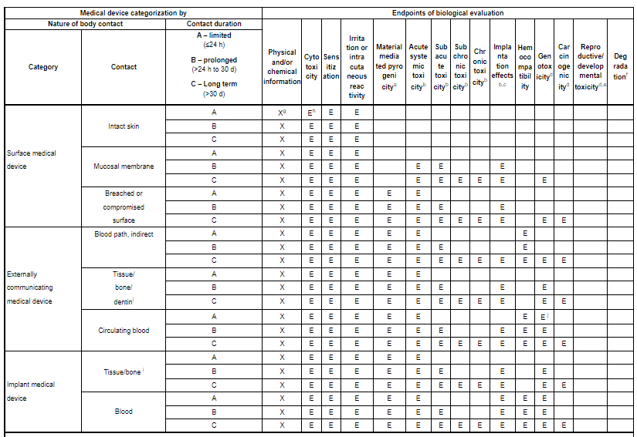
Annex A: Endpoints to be addressed in a biological risk assessment
Medical Device in Final Finished Form
Categorization of MD
Systematic approach to a biological evaluation
Biological Testing and
Risk management
Mitigate Risk by considering available information
Test Reports,
Device Master Files, Component and Device Documentation
Submission to FDA
TCS Internal

Slide 6

Annex B: Guidance on the conduct of biological evaluation within a risk management process
Medical Device in Final Finished Form
Categorization of MD
Systematic approach to a biological evaluation
Biological Testing and
Risk management
Mitigate Risk by considering available information
Test Reports,
Device Master Files, Component and Device Documentation
Submission to FDA
Biological evaluation is a component of risk management, and this Annex includes guidance on the application of ISO 14971 to the conduct of biological evaluation.
Risk analysis
Risk estimation
The process of identifying the specific hazards and assessing their significance.
Risk analysis begins with identification and characterization of the indirect and direct tissue-contacting materials and components of the medical device.
Physical and chemical, material properties are relevant to biological safety and should be identified at this stage
Risk is typically estimated by assigning values to the probability of occurrence of harm and the severity of that harm and can be estimated from knowledge of the actual availability of toxic components and the known dose response in relevant tissue(s). The severity can be assessed in terms of the nature of the toxic response.
If insufficient information is available, risk estimation can require conduct of chemical or physical characterization or biological testing.
Risk evaluation
Risk control
Risk Evaluation is the process used to compare the estimated risk against the given risk criteria to determine the significance of the risk.
Biological risk evaluation should be conducted by assessors with the necessary knowledge and expertise to determine the appropriate strategy for the evaluation.
Risk control is the process of identifying and implementing measures to reduce risks.
Design changes to avoid medical device failures
Reduction of toxicity by means of reformulation or materials change;
Changes to production processes to reduce or eliminate hazardous residues or process additives.
TCS Internal

Slide 7
Medical Device in Final Finished Form
Categorization of MD
Systematic approach to a biological evaluation
Biological Testing and
Risk management
Mitigate Risk by considering available information
Test Reports,
Device Master Files, Component and Device Documentation
Submission to FDA
To reduce unnecessary testing, FDA recommends to consider all available relevant information when conducting risk assessment.
Literature and other publicly available information
Clinical experience
Review available literature and other publicly available information to identify specific risks associated with the use of device and possible mitigation measures
For example: Literature could inform manufacturers that a process (nitinol passivation of a peripheral stent) should be conducted appropriately to ensure that nickel, a chemical with known toxicities, does not leach from the device when implanted.
Clinical experience should be considered in the overall benefit-risk profile for the device where the totality of the data available for the device may inform whether more testing is needed, or if any testing is needed at all.
For example, clinical experience may be useful to mitigate problematic findings in an in vitro biocompatibility or in vivo animal study.
Animal study experience
Medical device standards and Devices previously reviewed by FDA
Animal study data identifies adverse biological responses, some additional biocompatibility testing may be warranted.
For example, glutaraldehyde-fixed tissue heart valves may show toxic effects in animal studies as well as some standard biocompatibility assays, such as cytotoxicity and genotoxicity. These findings would usually trigger the need for additional studies, such as chemical characterization
Standards specific to a particular device type or material may be helpful to inform a risk assessment.
Experience with medical device materials previously reviewed by FDA (e.g., in previous generation devices, PMA approved devices, predicate devices) are also relevant for consideration as part of a risk assessment.
TCS Internal

Slide 8
Medical Device in Final Finished Form
Categorization of MD
Systematic approach to a biological evaluation
Biological Testing and
Risk management
Mitigate Risk by considering available information
Test Reports,
Device Master Files, Component and Device Documentation
Submission to FDA
Component Documentation
For each component and any joining processes/materials (e.g., adhesives, sintering processes), either of the following statements can be provided:
Comparison to test article: "The [polymer/metal/ceramic/composite name] [component name] of the test article is identical to the [component name] of the medical device in its final finished form in formulation, processing, sterilization, and geometry, and no other chemicals have been added (e.g., plasticizers, fillers, additives, cleaning agents, mold release agents)."
Comparison to previously marketed device: "The [polymer/metal/ceramic/composite name] [component name] of the medical device in its final finished form is identical to the [component name] of the [name] (legally US-marketed device)70 in formulation, processing, sterilization, and geometry, and no other chemicals have been added (e.g., plasticizers, fillers, additives, cleaning agents, mold release agents).“
Device Documentation
If the above statement is true for all the device component material formulations, processes, and sterilization methods (if applicable) in the device, either of the following general statements can be provided:
Comparison to test article: "The test article is identical to the medical device in its final finished form in formulation, processing, sterilization, and geometry and no other chemicals have been added (e.g., plasticizers, fillers, additives, cleaning agents, mold release agents).“
Comparison to previously marketed device: "The medical device in its final finished form is identical to [name] (previously marketed device) in formulation, processing, sterilization,
TCS Internal

Slide 10
Biological Evaluation Plan
The biological evaluation plan should be drawn up by a knowledgeable and experienced team and include as a minimum:
— arrangements for gathering of applicable information from the published literature (including information sources and search strategies), in house and supplier data and other sources in order to conduct risk analysis;
— arrangements for conducting the evaluation, including the requirement for any specific technical competencies relevant to the specific medical device application;
— arrangements for review and approval of the plan as part of the overall design control process;
— arrangements for review of the final conclusions of the evaluation and the approval of any additional testing required;
— arrangements for the final review and approval of the outcomes of the biological risk assessment, including the risk control measures applied and the documentation of any residual risks and the disclosure of residual risks through means such as product labelling.

Slide 11
A major component in hazard identification is material characterization (see ISO 10993-18 and ISO/TR 10993-19). The following steps can be identified:
— define and characterize each material, including suitable alternative materials;
— identify hazards in materials, additives, processing aids, etc.;
— identify the potential effect of downstream processing (e.g. chemical interactions between material components, or final product sterilization) on chemicals present in final product;
— identify the chemicals that could be released during product use (e.g. intermediate or final degradation products from a degradable implant);
— estimate exposure (total or clinically available amounts);
— review toxicology and other biological safety data (published/available).
Information on biological safety to be reviewed can include:
— toxicology data on relevant component materials/compounds;
— information on prior use of relevant component materials/compounds;
— data from biological tests.

